Slide 1

RealEase: Comprehensive Real Estate Insights Platform
Milestone 1 Briefing
By Donovan Murphy, Jonathan Bailey, and Enrique Obregon

Slide 2
New Logo and Visual Identity
RealEase is now equipped with a refined color scheme and a professional logo.
Advisor feedback: Convert the logo to an SVG format for optimal web performance.

Slide 3
Milestone One Task Matrix
Task | Completion % | Donovan | Jonathan | Enrique | To do
Investigate tools | 85% | 50% | 20% | 30% | Investigate javascript functions and card layout on the home screen.
Hello World demos | 75% | 20% | 10% | 60% | Improve on early stage demo, increase the size, improve layout, and figure out what we want to cache vs call.
Requirement Document | 100% | 20% | 60% | 20% | Done, just make sure to go back and update if we incur any roadblocks.
Design Document | 100% | 80% | 20% | 20% | Done, just need to build on wireframes.
Test Plan | 100% | 20% | 20% | 60% | As features progress, add more test cases.
Narrow Down List of API’s | 60% | 40% | 10% | 10% | Done, we have our set list of API’s and have begun testing them.
Front End Layout, logo, and color scheme | 90% | 70% | 15% | 15% | Logo is complete, but continue to research other options for accent color.

Slide 4
Task 1: Software Stack Selection
The team finalized the MERN stack (MongoDB, Express, React, Node.js) for the project due to its scalability, flexibility, and efficiency in handling real-time data.
The decision was backed by our advisor and aligns well with the project’s data-heavy requirements.

Slide 5
Task 2: Narrowing API List
After reviewing several real estate and neighborhood data APIs, we chose to focus on Realty in US for our demo.
We also tested other APIs, such as Crime Data and SchoolDigger, to ensure they align with future features like the Neighborhood Insights Dashboard.

Slide 6
Task 3: API Integration & Hello World Demo
The team successfully ran a Hello World demo by integrating the Realty in US API.
We encountered some technical challenges related to API key handling and data formatting, but these were resolved with the advisor's guidance.

Slide 7
Task 4: Document Completion
Requirements, Design, and Test Documents were completed after several iterations and refinements based on faculty advisor feedback.
Focus was placed on ensuring detailed, modular descriptions of the platform’s core features and how data flows through the system.

Slide 8
Milestone Two Plan
Task | Donovan | Jonathan | Enrique
1. Continue to develop DB schema, caching, and investigate scheduled API calls | implement/test 40% | Research 20% | Demo 40%
2. Continue Planning and begin development of the front end website and how we want to query and display results. | Design 30% | Design 30% | Design 40%
3. Begin looking into 3 features and plan integration with the data set. | Implementation and test 20% | Research and early testing 50% | Test 30%
4. Refining API List and Continued Testing | Refine and test 70% |  | Test and Demo 30%

Slide 9
Task 1: Database Schema, Caching, and Scheduled API Calls
The team will finalize the MongoDB schema, ensuring it handles property, neighborhood, and user data effectively.
We'll investigate caching mechanisms to optimize frequently accessed data and explore scheduled API calls to keep the platform updated with the latest data.

Slide 10
Task 2: Front-End Development
Continued development of the front-end in React, focusing on displaying results from user searches, including Neighborhood Insights, property listings, and ROI calculations.
We will also implement responsive design for improved user experience on different devices.

Slide 11
Task 3: Feature Integration
Begin integrating data from the APIs into key features like the Neighborhood Insights Dashboard, Home Comparison Tool, and ROI Calculator.
Plan how data will be displayed and queried for each feature to ensure seamless functionality.

Slide 12
Task 4: Testing and Refining API Integrations
We will continue testing the APIs, focusing on error handling and ensuring smooth data retrieval.
The team will refine fallback strategies for instances where APIs return incomplete or slow data.

Slide 13
Faculty Advisor Feedback
Advisor was pleased with the color scheme and provided guidance on the logo design, recommending we use SVG format for scalability.
Hello World demo was completed following specific suggestions on API integration.
Advisor emphasized the importance of detailing how data is stored and cached for each feature, and how users will navigate the platform.

Slide 14
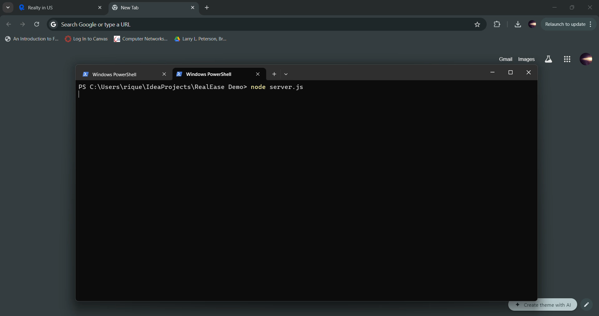
Hello World Demo

Slide 15

Questions?

